Slide 1
CGB1201 – JAVA PROGRAMMING
Department of Artificial Intelligence and Data Science
Academic Year: 2024 – 2025 (Odd Semester)
Register Number : 2303811724321081
Name : Pradeep M
Year :2nd
Semester :3rd
Section :B
Date :03/12/2024

Slide 2
Title of the Project
DIGITAL NOTICE BOARD SYSTEM

Slide 3
Problem Identification
Digital notice boards face several challenges that can hinder their effectiveness. Content management can be cumbersome, with difficulties in updating notices, lack of automation, and redundant or outdated information creating clutter. Accessibility issues also arise, such as poor visibility under certain lighting conditions, language barriers for diverse audiences, and complex interfaces that alienate non-tech-savvy users.

Slide 4
Objective
The objective of a digital notice board is to provide an efficient, user-friendly, and visually appealing platform for displaying information. It aims to streamline content management, ensure timely updates, enhance accessibility for diverse audiences, and reduce reliance on traditional paper-based notices. By leveraging technology, digital notice boards seek to improve communication, minimize operational challenges

Slide 5
Proposed Architecture
Admin panel
Post new notice
Update exciting notice
View notice
logout
Login (Admin/User)

Slide 6
Java Programming - Concepts Used
Login (Admin/User):
The system begins with a login module where users authenticate themselves.
Admin users have full access to manage notices, while regular users can only view notices.
Admin Panel:
Admins gain access to a dedicated dashboard where they can manage the entire notice system.
It provides options for posting, updating, and managing notices.
Post New Notice:
Allows admins to create and publish new notices.
Notices may include text, images, or multimedia content.

Slide 7
List of Modules
User Authentication Module
Admin Panel Module
Digital Display Module
Notification System Module
Report Generation Module
User Interface Module

Slide 8
Module Description
User Authentication Module:
Allows users to log in using a username and password.
incorporates Java classes for authentication and role-based access
Admin Panel Module :
Options to post, edit, and delete notices.View usage logs and manage user accounts.Assign schedules for notices and multimedia content.
Digital Display Module:
Dynamically renders notices in text, image, or video formats.Supports scheduling to display notices at specific times.Automatically updates content in real-time based on admin inputs.

Slide 9
Module Description (Cont..)
Notification System Module:
sends push notifications, emails, or SMS to registered users.Allows admins to configure notification settings (e.g., frequency, target audience).
Report Generation Module
Generates reports on notice views, updates, and user engagement.Exports reports in formats like PDF or Excel.Tracks admin activity logs for system monitoring.
User Interface Module
Provides an intuitive layout for admins to manage notices and for users to view them.Supports responsive design for mobile and desktop devices.Includes features like search functionality and multimedia previews.

Slide 10
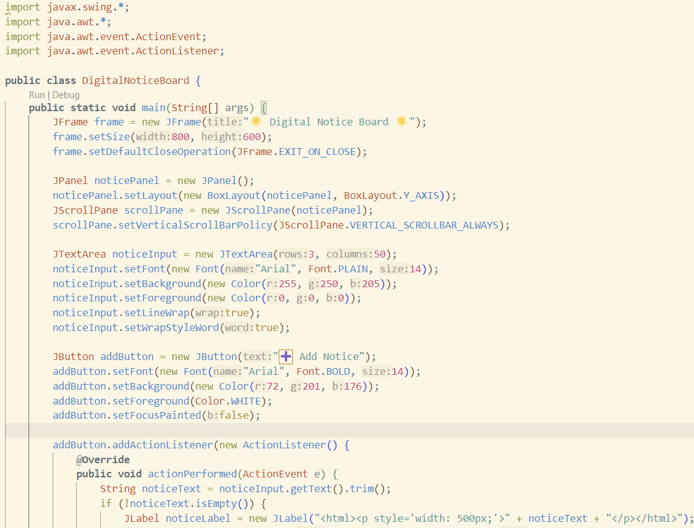
Source Code

Slide 11
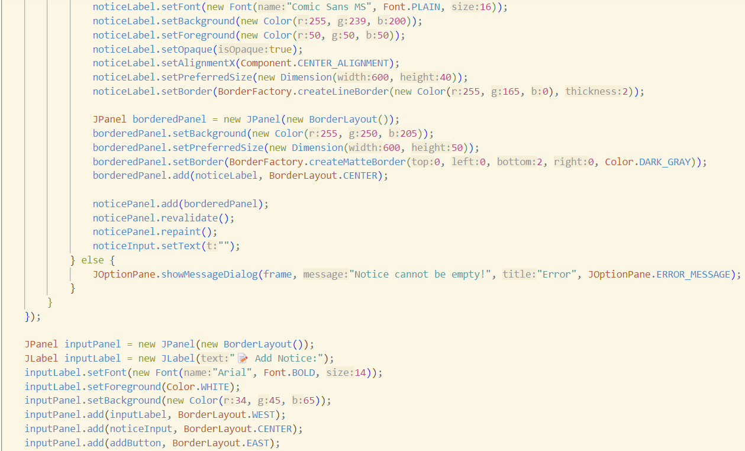
Source Code

Slide 12
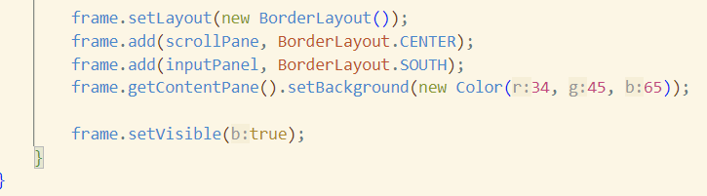
Source Code

Slide 13
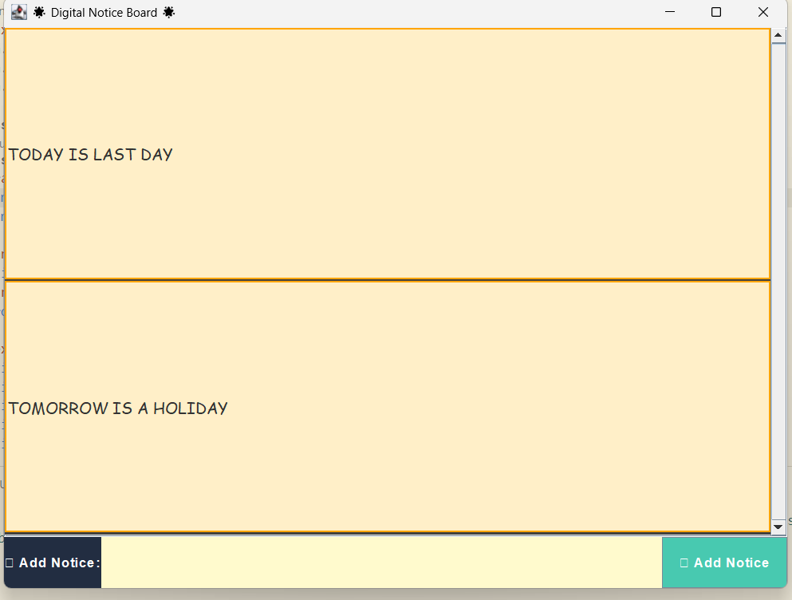
Results

Slide 14
Conclusion
In conclusion, digital notice boards represent a modern and efficient approach to information dissemination, addressing many limitations of traditional notice boards. By offering real-time updates, improved accessibility, and reduced environmental impact, they provide a sustainable and user-friendly solution. However, to maximize their effectiveness, it is crucial to address challenges such as content management, accessibility, and technical reliability.

Slide 15
Thank You
Any queries???

